Slide 1
Exam 2 Review Session
10/23/17

Slide 2
Plato, camus, & nagel
the meaning of life

Slide 3
Socrates on Ignorance and Wisdom
‘For my part, I thought to myself as I left, “I’m wiser than that person. For it’s likely that neither of us knows anything fine and good, but he thinks he knows something that he doesn’t know, whereas I, since I don’t in fact know, don’t think that I do either. At any rate, it seems that I’m wiser than he in just this one small way: that what I don’t know, I don’t think I know.”’ (Apology, p. 26)

Slide 4
Socrates on Death
“What has happened to me may well be a good thing, and those of us who believe death to be an evil are certainly mistaken. I have convincing proof of this …” (Apology, p. 43)

Slide 5
Camus on the Absurd
“The workman of today works everyday in his life at the same tasks, and his fate is no less absurd [than Sisyphus’].”
“If there is a personal fate, there is no higher destiny, or at least there is, but one which he concludes is inevitable and despicable.”
“But …”

Slide 6
Sisyphus as ‘the Absurd Hero’
“… crushing truths perish from being acknowledged.”
“It is during that return, that pause, that Sisyphus interests me. … At each of those moments when he leaves the heights and gradually sinks toward the lairs of the gods, he is superior to his fate. He is stronger than his rock.”

Slide 7
Nagel: Arguments for Meaninglessness?
Argument: Nothing we do will matter in a million years.
Argument: We are tiny, instantaneous specks in an almost infinitely vast and endless universe.
Argument: Since we will all eventually die, the chain of justifications has to end somewhere.

Slide 8
Nagel on the Absurd
“In ordinary life a situation is absurd when it includes a conspicuous discrepancy between pretension or aspiration and reality …”
Nagel gives examples: p. 718.
The absurdity of life results from a discrepancy between the seriousness with which we live our lives, and the fact that, from a cosmic point of view, we cannot justify this.

Slide 9
Nagel: What Could Give Life Meaning?
(1) Viewing oneself as part of something larger than oneself: society; the progess of history; God’s plan; the revolution
(2) Camus: “We can salvage our dignity, he appears to believe, by shaking a fist at the world which is deaf to our pleas, and continuing to live in spite of it.” (p. 726)

Slide 10
Dennett
Where Am I?

Slide 11
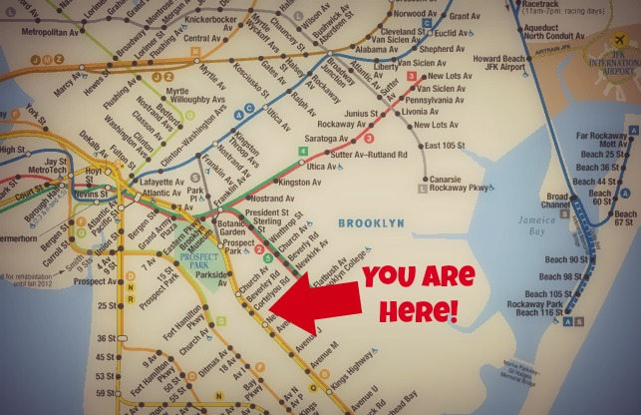
Here
Where is “here”?

Slide 12
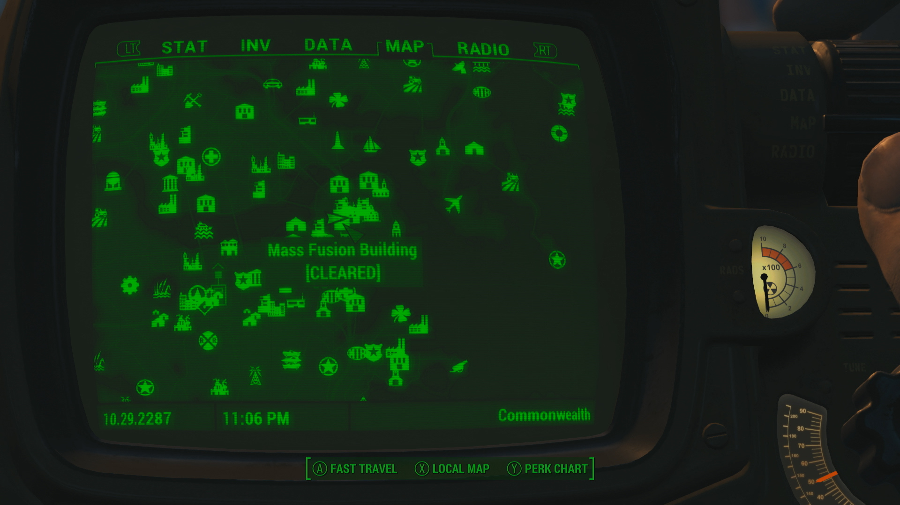
Objective

Slide 13
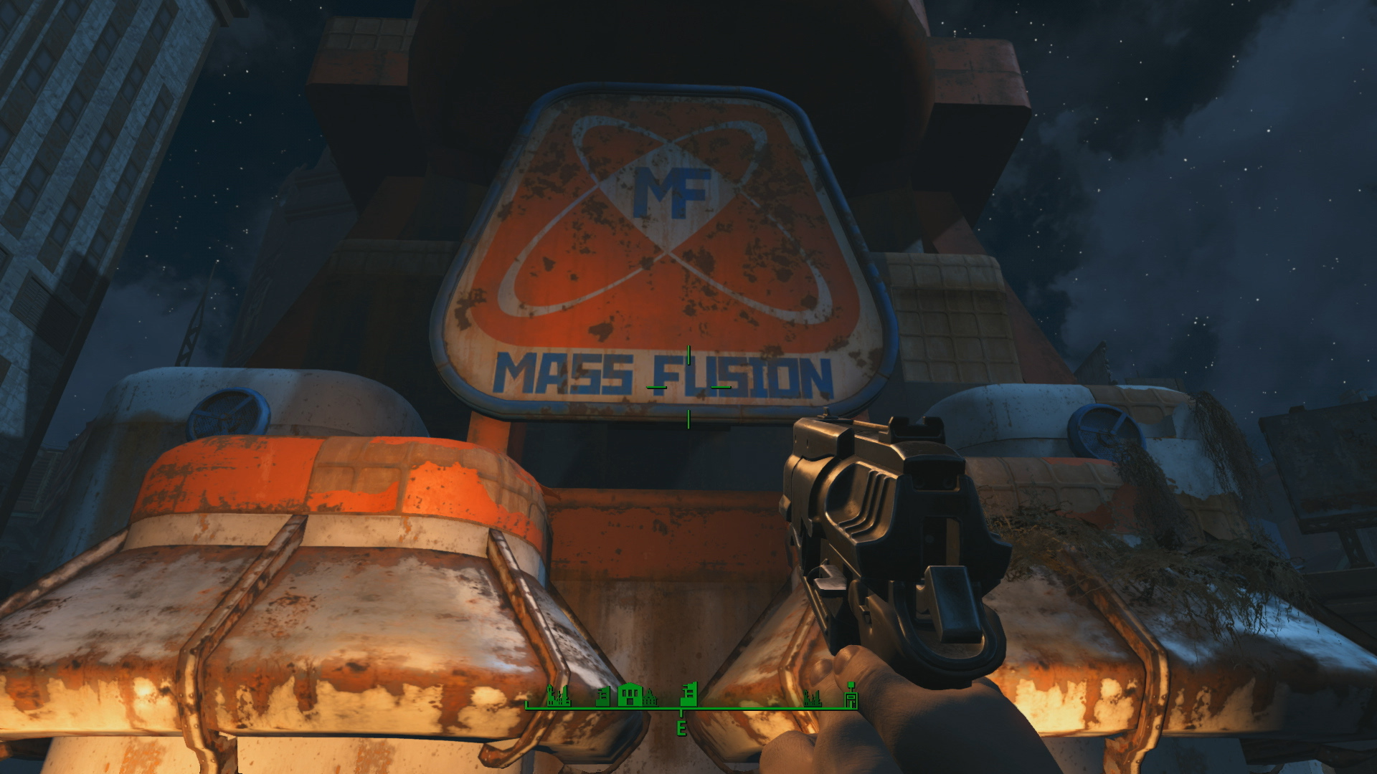
Subjective

Slide 14
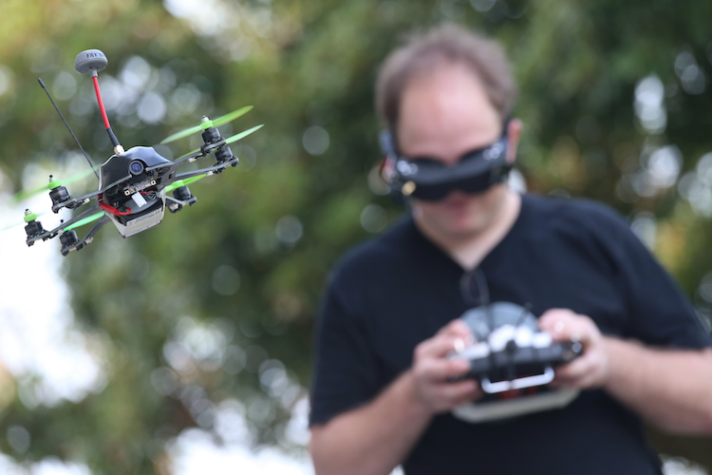

Slide 15
Is the self located:
Where thought occurs? (The cognitive center)
Where sensation or action occurs? (The perceptual center)

Slide 16
Scenario One
My brain is in a vat, across from which is my body, with eyes viewing that brain
My body travels progressively further from my brain, while the sensations of my body are still transmitted to the brain and the commands of my brain result in bodily motions

Slide 17
Scenario Two
The transmissions between my body and my brain end, such that my body is located in one place and my body in another, but no sensations from my body are sent to my mind and no commands from my body result in bodily motions
Fully active brain, but as if senseless and paralyzed

Slide 18
Scenario Three
My brain is in a vat, across from which is my *new* body, with *new* eyes viewing that brain
My *new* body travels progressively further from my brain, while the sensations of my *new* body are still transmitted to the brain and the commands of my brain result in motions in the *new* body

Slide 19
Scenario Four
The sensations of my new body are transmitted to two different systems: one is my brain, and the other is a computer
My brain and the computer think identical thoughts, and produce the same commands for the movements of my body
Sometimes, my brain moves my body, and sometimes, a switch is flipped, and the computer moves my body
It is indistinguishable to my brain and the computer which is in control without checking the switch

Slide 20
Scenario Five
The sensations of my new body are transmitted to two different systems: one is my brain, and the other is a computer
My brain and the computer think *different* thoughts, and produce *different* commands for the movements of my body
Sometimes, my brain moves my body, and sometimes, a switch is flipped, and the computer moves my body
It is *distinguishable* to my brain and the computer which is in control without checking the switch
Fully active brain and computer, but is as if the one not in control is “possessed”

Slide 21
Edelman
Cognitive science and selfhood

Slide 22
edelman essentials
Levels of cognition
Experience as simulation
Four key components of first-person experience

Slide 23

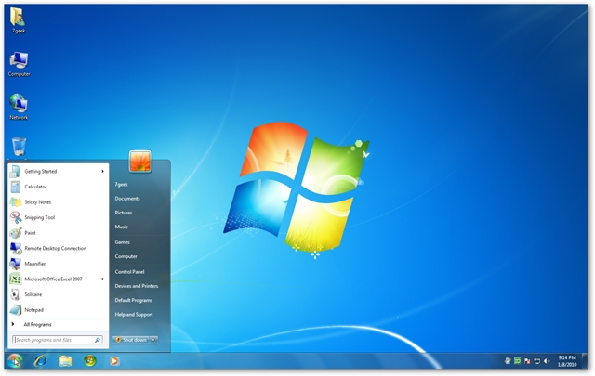
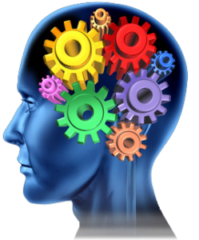

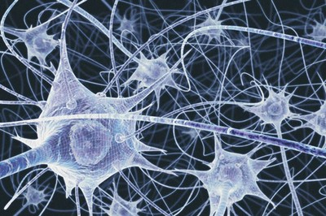
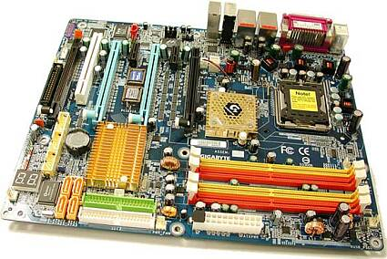
Levels of cognition
Consciousness
Computational
processing
Neural activity

Slide 24
Experience as simulation
What does this mean?
Experience is constructed
You see what your brain wants you to see
Sensory data
data data data data data data data data data
Processing
Conscious experience

Slide 25




Components of first person experience
Agency
Mineness
Perspectivalness
Selfhood

Slide 26
Borges
Am I who I seem to be?
What is the true nature of the self?

Slide 27
Nagel on the Objective Self

Slide 28
The problem: How can I be a particular person?
Recall: The physical conception of the world (the world as it is described by Physics) leaves out some important facts about the world, namely the subjective (mental) experiences of individual people.
Similarly a centerless description of the world that includes both physical facts and subjective experiences still seems to leave out one important point: Who am I in the world?

Slide 29
The centerless view of the universe (or the View from Nowhere)
The first-person point of view

Slide 30
Two puzzles:
How can it be true of a particular person in an objectively centerless world that he is me?
How can I be merely a particular person? (Or: How can I be something as specific as a particular person?)

Slide 31
About (1):
There is something that can’t be included in the objective conception of the world, namely that “one of those persons (TN) is the locus of my consciousness, the point of view from which I observe and act on the world”
The objective centerless conception of the world has no room for particular points of views. But if such facts are not part of such a conception of the world, then what are they?

Slide 32
About (2): How can I be merely a particular person?
The self that seems incapable of being anyone in particular is the self that apprehends the world from without rather than from a standpoint within it - The Objective Self.

Slide 33
The Objective Self
The idea: The objective self takes the inputs of your first-person perspective as data to construct an objective picture of the world.
“It is simply the step of conceiving the world as a place that includes the person I am within it, as just another of its contents - conceiving myself from outside, in other words. So I can step away from the unconsidered perspective of the particular person I thought I was.”
In this way I reach a centerless view of the universe.

Slide 34
The problem arises because I am the subject of this centerless view of the universe but I am also a part of the universe that I am conceiving

Slide 35
When we say “I am TN” then the “I” refers to this impersonal conception of the world. What’s strange is that this conception, though it accords no special position to TN, is still attached to and developed from the perspective of TN. This is the puzzling fact about asking how it could be that I am merely a person in this universe.

